Slide 1
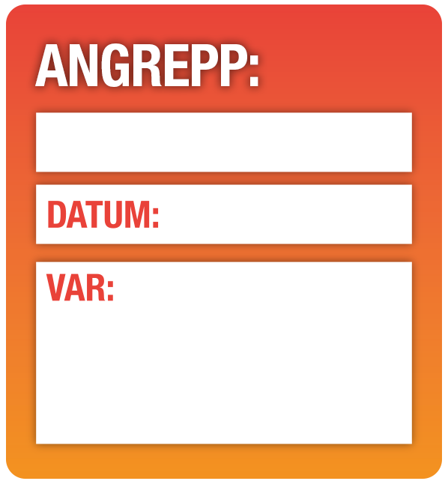
Lorum ipsum
Dolar sequi
Lorum ipsum
Dolar sequi
Lorum ipsum
Dolar sequi
Lorum ipsum
Dolar sequi
Lorum ipsum
Dolar sequi
Lorum ipsum
Dolar sequi
Lorum ipsum
Dolar sequi
Lorum ipsum
Dolar sequi
Lorum ipsum
Lorum ipsum
Dolar sequi
Lorum ipsum
Lorum ipsum
Lorum ipsum
00/00/18
00/00/18
00/00/18
00/00/18
00/00/18
Lorum ipsum
Dolar sequi
Insert text
Lorum ipsum
Dolar sequi
Insert text
Lorum ipsum
Dolar sequi
Insert text
Lorum ipsum
Dolar sequi
Insert text
Notes:
To use the Fungicide Planning guide:
1. Assess disease risks and potential infection timing for your course, based on your historical knowledge; planned events that could trigger disease; GreenCast Historical Disease Risk records and other individual risk factors. The red bands at the top of the poster indicate when each disease is most likely in typical conditions across the country. Drag and Drop the Disease stickers to indicate when you expect infection periods on your course – move the sticker than just Zoom In and type the info.
2. Drag and drop the Maintenance Week and Key Event stickers to highlight periods of high risk or when you know you need to have turf in top condition. Its easy to write on these as well.
3. Drag and Drop appropriate fungicide choice in front of your expected disease outbreaks or events, to give the best chance of preventing infection and plant damage. Use the Application Timing panel as a guide to the most appropriate choice in typical weather and growing conditions. Download the Guide in the bottom right of the Plan to check you are using best practice for product choice and FRAC guidelines for resistance management.
4. Assess your fungicide plan pre-season to calculate costs, priorities and budget requirements. Use the poster to help explain your plan and gain support from the Club if required.
5. Add in other turf management components of Primo Maxx II; Qualibra and Ryder as required for your course.
6. Continue to use and adapt the plan through the season. If conditions and risks change, adapt the programme accordingly. Move or add disease stickers for when and where infection actually occurred and move the fungicide stickers to when you actually applied treatments – which will give an even better indication for next season on your course.
7. Review the success of the Plan at the end of the season. Share and discuss with your agronomist or other greenkeepers to decide what worked and what could be done better next season.
8. Save your records of this season, and then Save as…to start a new Plan for next year.
Download the accompanying ‘Planning Your Proactive Fungicide Programme’ guide from the GreenCast website for more ideas and information: https://www.greencast.co.uk/file/14286/download (cut and paste this link into your browser)

